Slide 1
QUIQ
foods

Slide 2
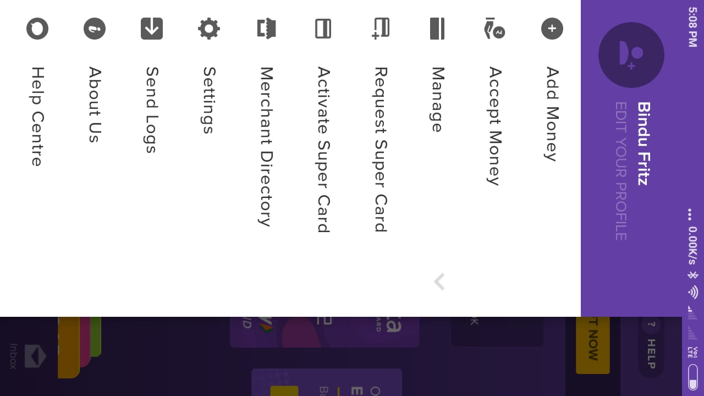

Slide 3
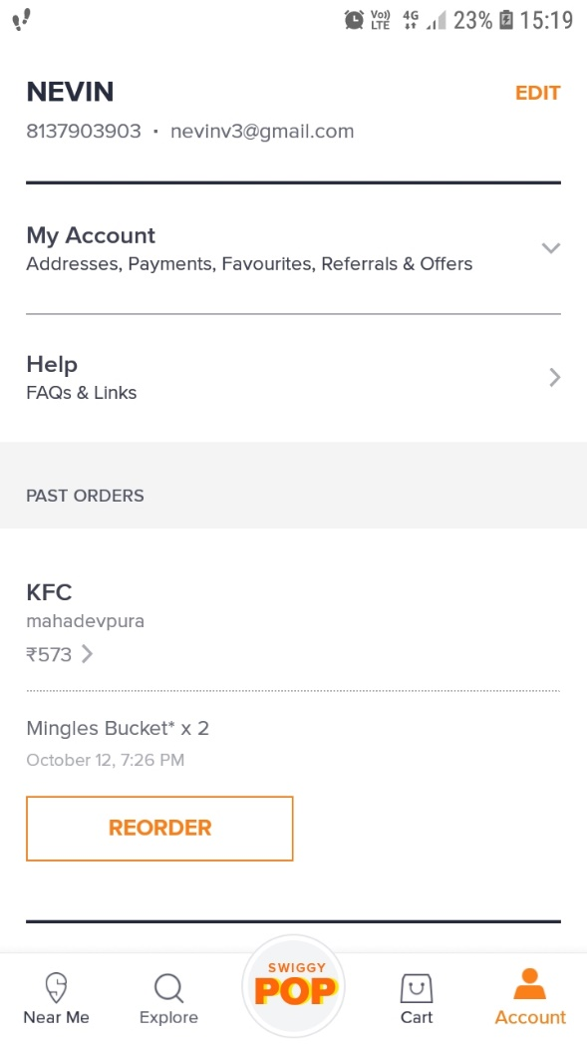
Account

Slide 4
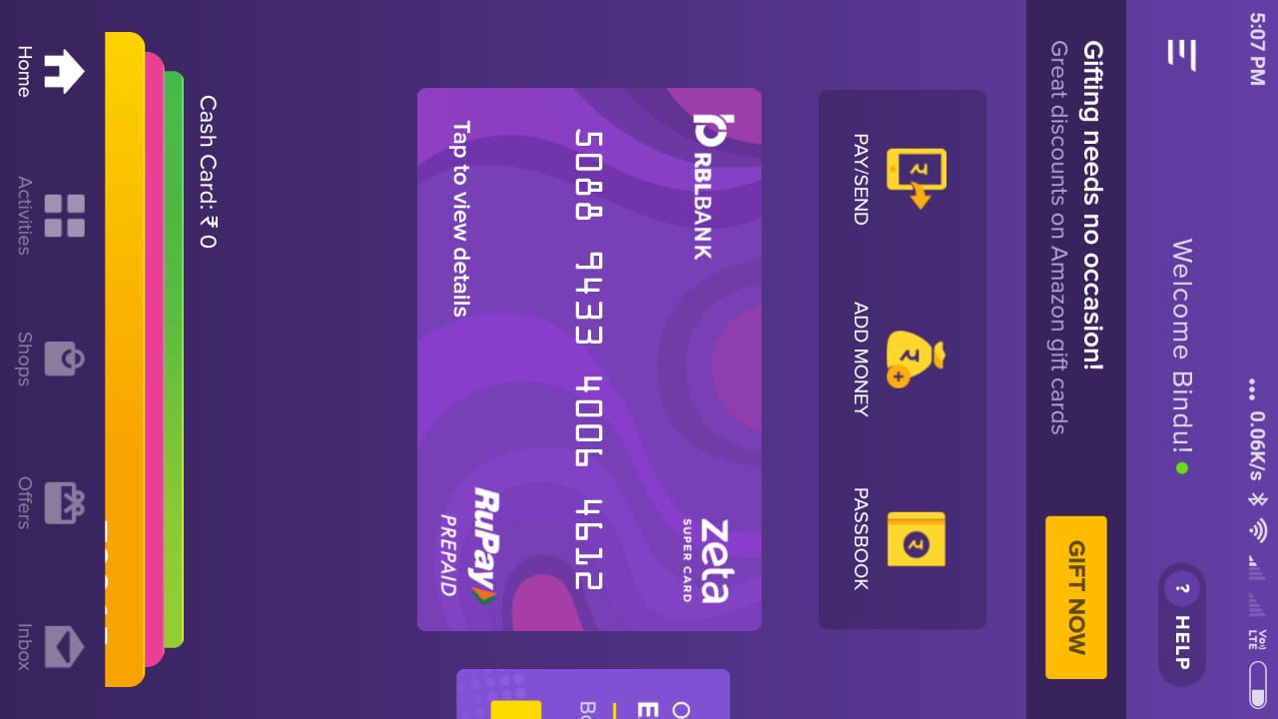
Wallet can see in putting under section Account

Slide 5
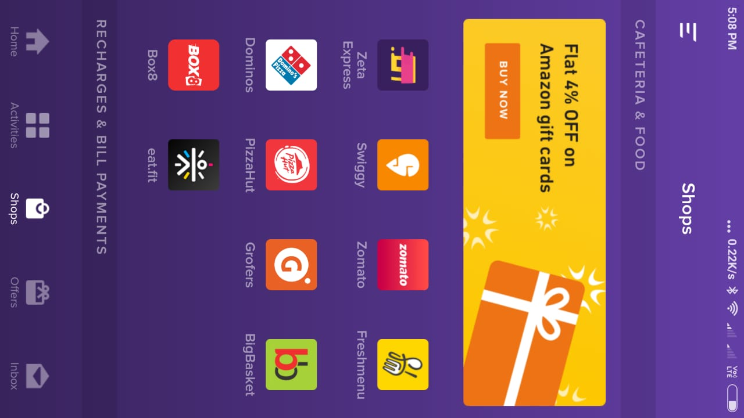
Shops/POS (based on location – option for select location)

Slide 6
Food menu listing page
Refer swiggy, zomato etc

Slide 7
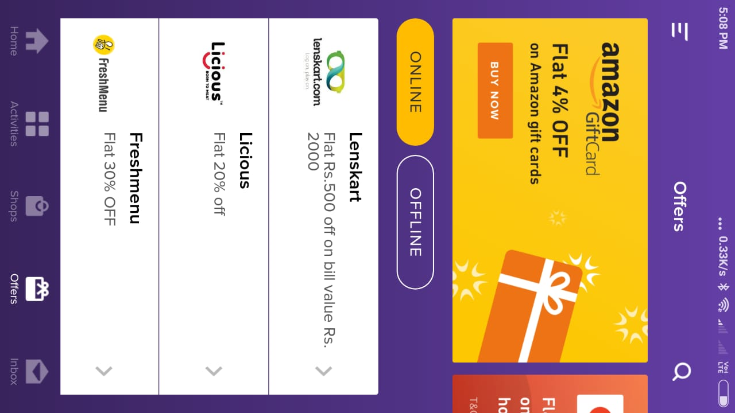
Offers/ Apply coupons

Slide 8
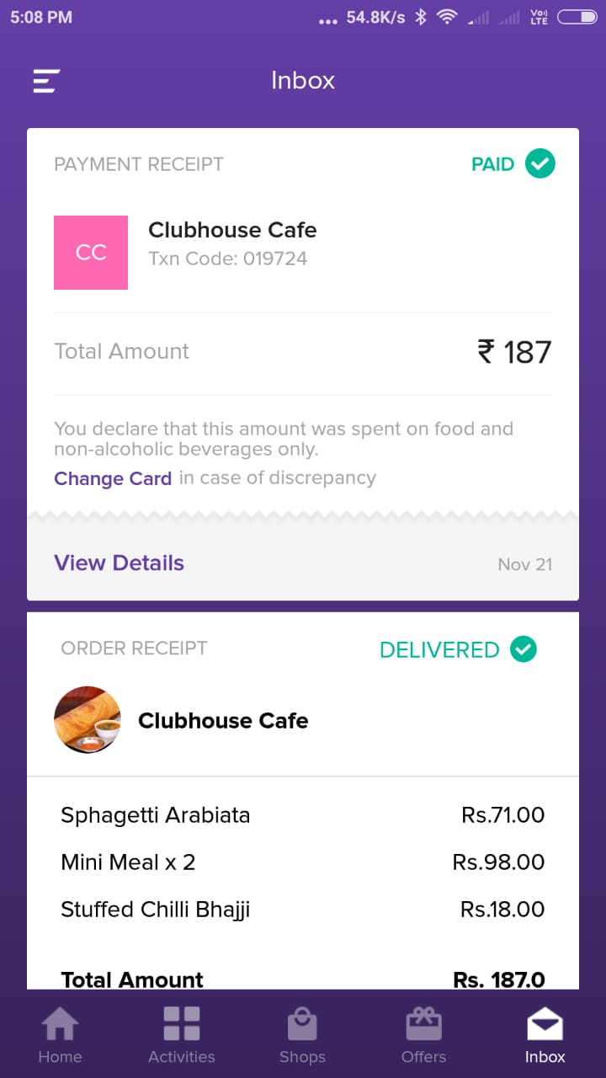
Transactions (messages)

Slide 9
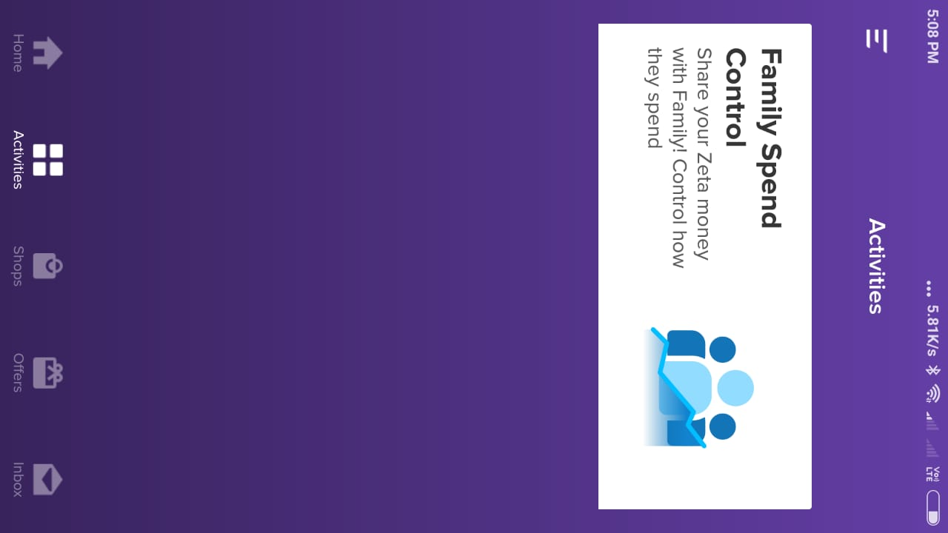
Activities/ Notifications

